Slide 1
Scholastic Esports
Why you should consider building a program at your school (even if you know nothing about gaming)

Slide 2
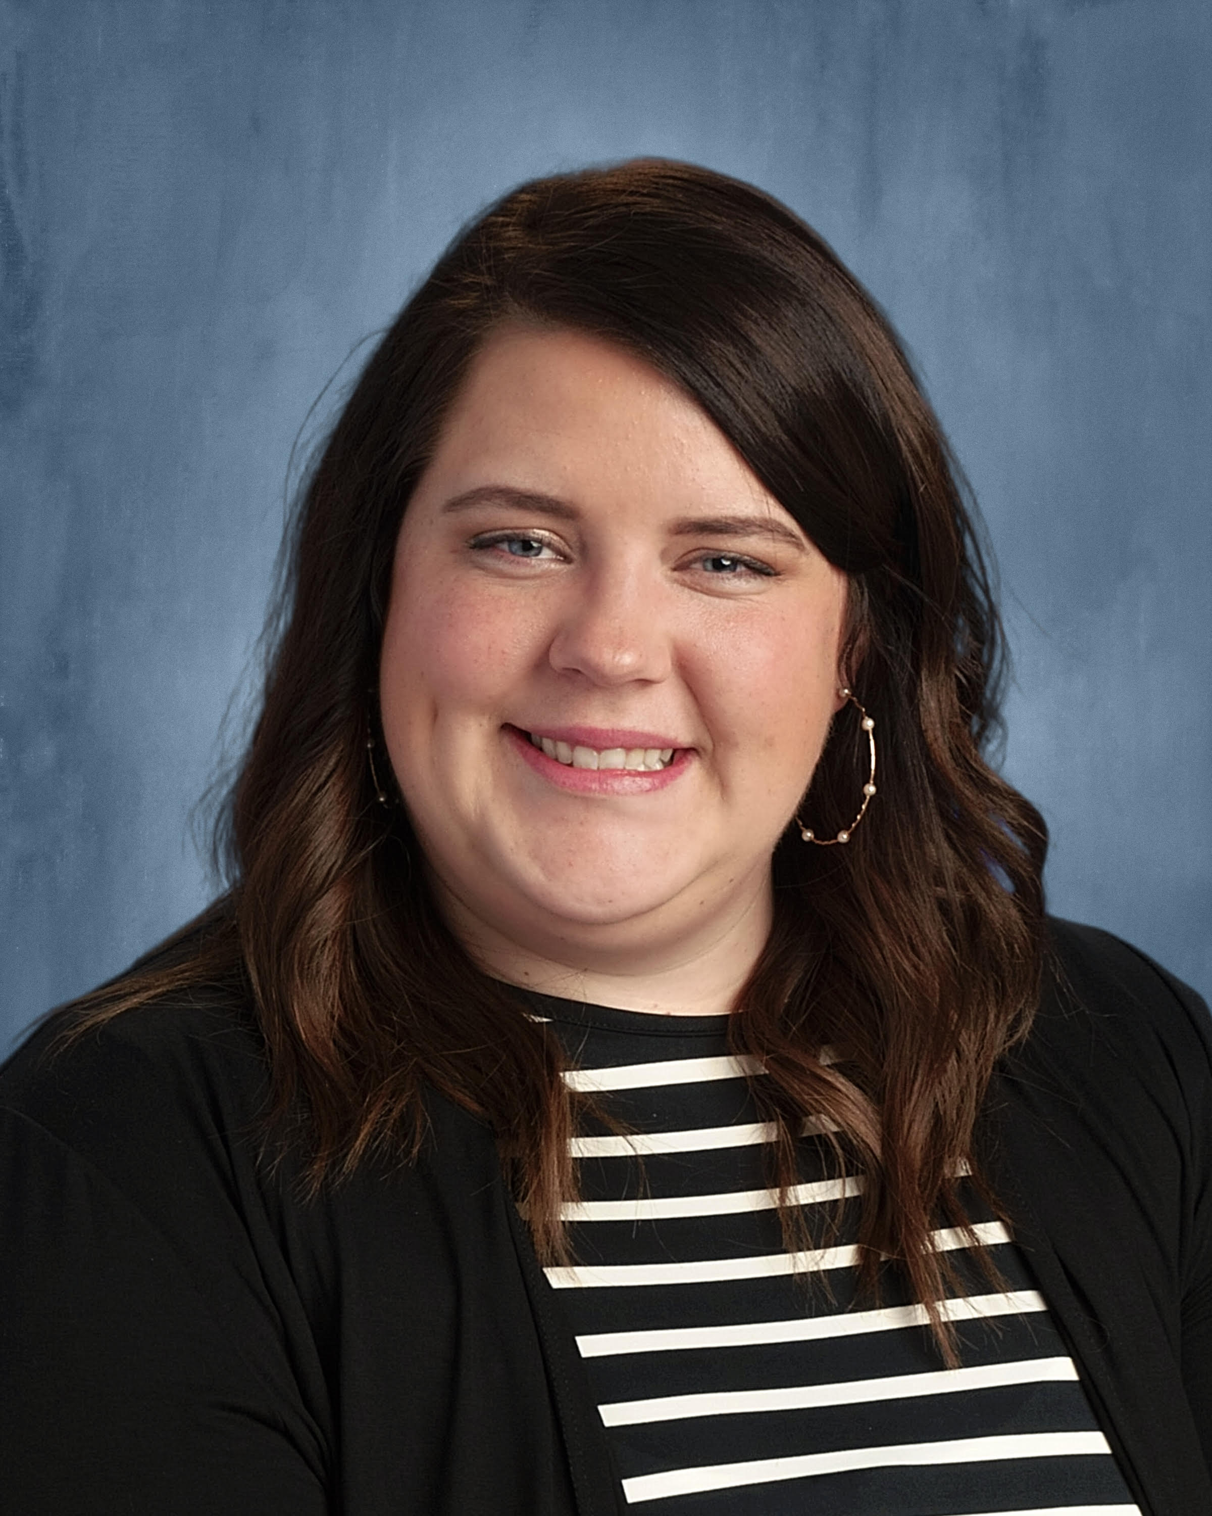
About Me
B.S. Technology & Engineering Education
(almost) M.S. in I.T. Management
CS/IT teacher for 6 years in Alpine School District
Adjunct for 4 years
Director of Technology Education, Success in Education Foundation

Slide 3
What we’re talking about today
Why esports?
My story with esports
Esports research
How esports compliments CTE
Resources
Creative ways to offer more pathways
Alpine School District’s “Advanced CS and Advanced IT” examples
How TestOut products support our programs
Notes:
My goal today is to help you see the “why” behind esports in education.
I am going to share with you some of my experiences as an educator in helping to bring esports to Alpine School District and how it has benefitted my students.
Then I am going to turn the time over to the ASD network engineers, Matt and Bryson, who have been instrumental in building the technical education programs in Alpine. They are going to share a brief overview of the solutions they have implemented. I will then wrap things up with some classroom examples and a fun activity.
We will be available during a breakout session at 3 where we hope you will join us and other districts who are implementing esports to connect and ask more questions. Matt and Bryson will again be joining us virtually and I will be joined by my coworker from the Success in Education foundation, Maddie Park, to discuss all things esports, including ways to support districts, schools, educators and students in their efforts.

Slide 4
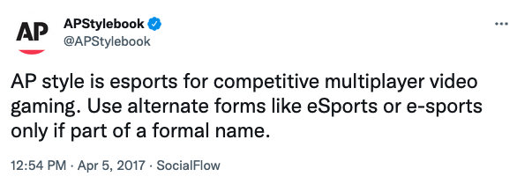
Why esports?
First, let’s talk about spelling: Esports, or esports, or e-sports, or eSports

Slide 5
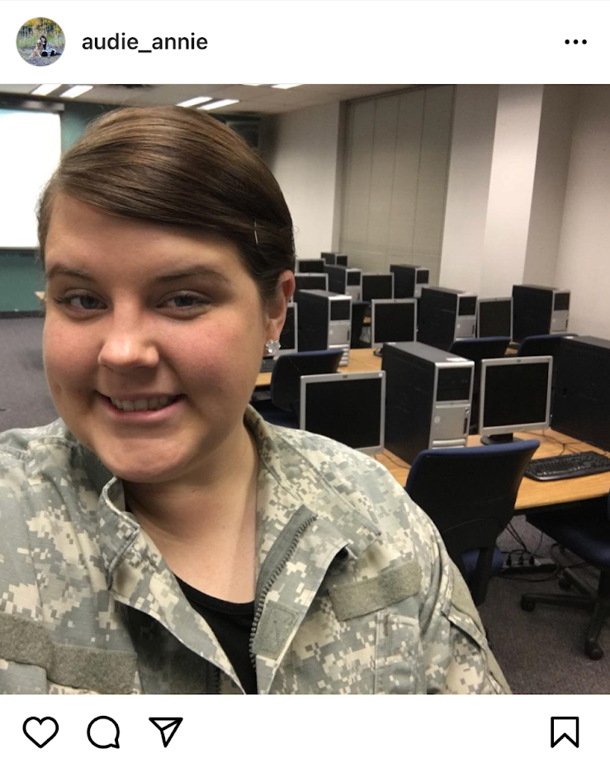
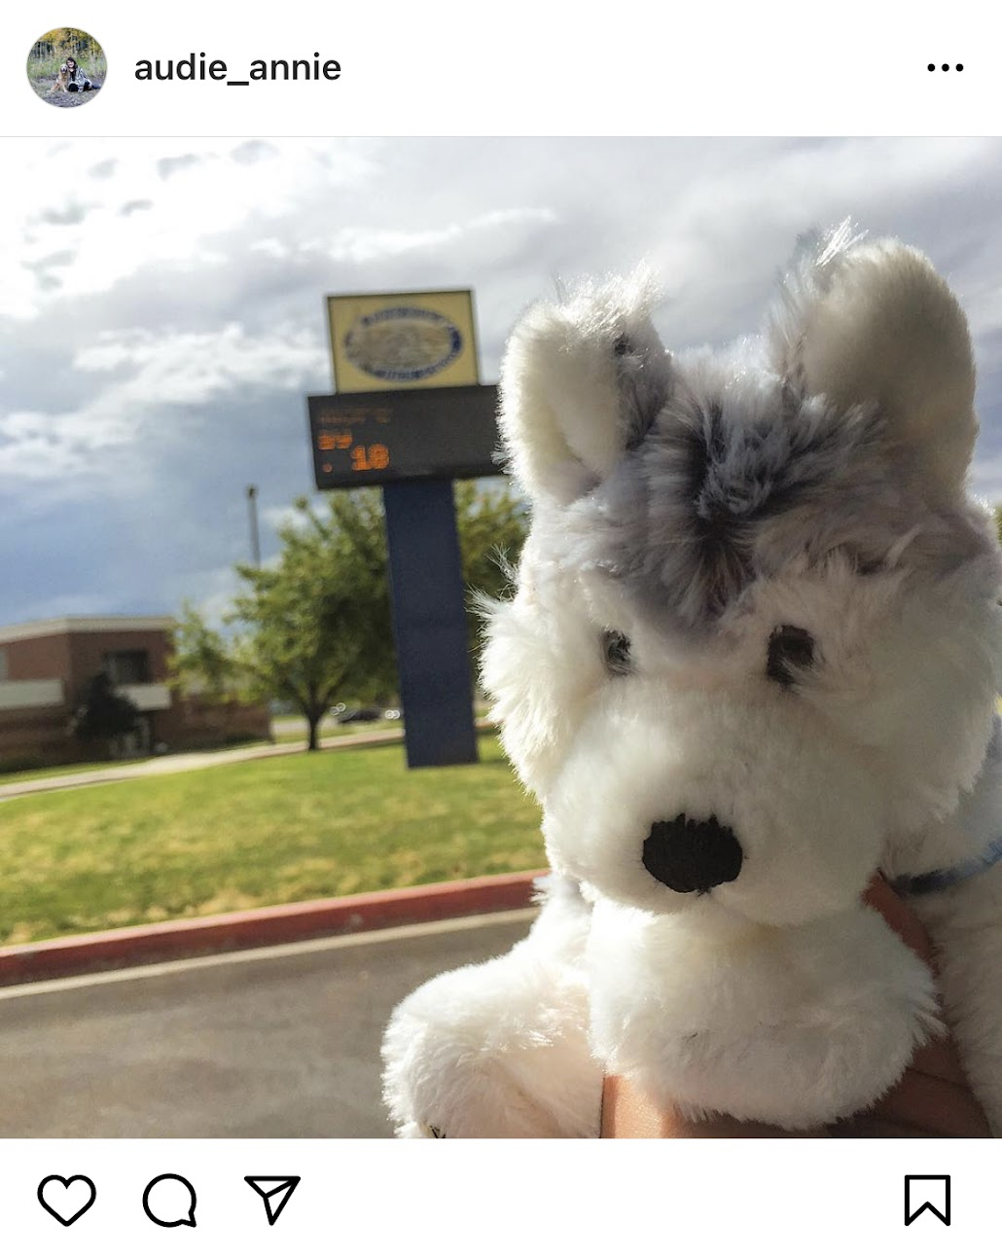
Why esports?
Notes:
In 2015 I landed my first teaching job at Timpanogos High School in the Alpine School District. I was fresh out of college, working part time at Ancestry as a development release coordinator, and now, teaching web development and digital business applications. My first teaching job was hourly, but I was just happy to be teaching. Finally having earned my degree and putting it to use.
My mentor teacher, an hourly teacher who actually still works full time as a developer at Microsoft taught 1st period, so I would come in early to observe him teach and help his programming students with their projects.
One of these students, Owen, really liked Minecraft. One day, early in the year, Owen approached me about starting a club at school. He wanted to start a Minecraft club.

Slide 6
Why esports?
Notes:
Now, I don’t know if you were around in 2015 in the education scene in Utah, but esports was nowhere on the horizon yet. Me, as an hourly teacher, asking my administration to support a club dedicated entirely to a video game did not seem realistic.
Owen is Autistic and after a little back and forth about the club we were going to create, we decided to form an Autism Club (where one of the main activities could be Minecraft–if we could get it working at school). But we could also do smash bros or chess or, UVU had just opened their new Autism center and we wanted to go tour their building to see what resources UVU had available to autistic students.
I loved how excited Owen was to own that part of who he is and to help create a space for others to learn more about autism and feel connected to the school.

Slide 7
Why esports?
Notes:
I actually found the original club application in my google drive while prepping for this presentation.
I want you to look closely at the club objective. Let me zoom in.

Slide 8
Why esports?
Notes:
Unify students by providing them with team building experiences and exercises to grow as individuals and as a group.

Slide 9
Why esports?
Notes:
You can see here some of the upcoming events we were planning on holding.
Owen became the founder and president of a club to his peers. A leadership opportunity he likely wouldn’t have had in high school without this club.
At Timpanogos we didn’t have any consoles to play on, so smash bros never happened, but before long, Owen had recruited a bunch of students to join our club. Some austistic, some not, the club was open to everyone. We were even able to secure a small charitable donation from my other job at Ancestry, which allowed us to purchase some Minecraft EDU licenses–back in the day before Microsoft had revamped it.

Slide 10
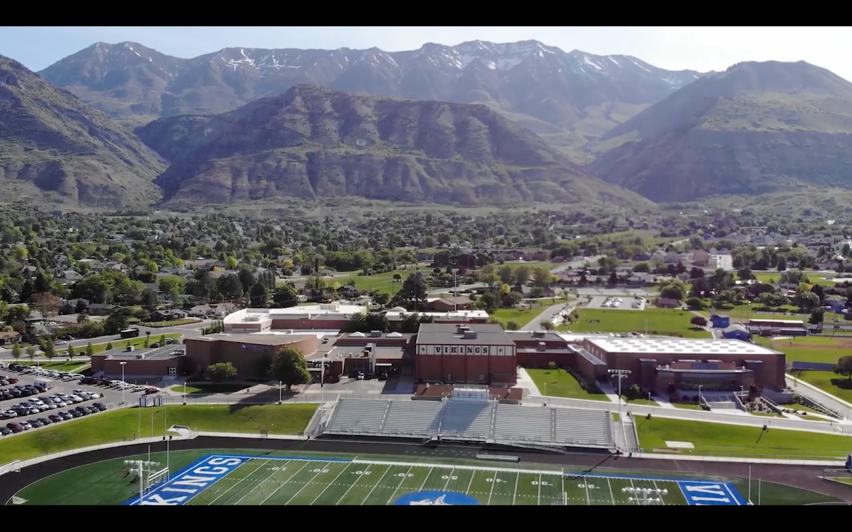
Why esports?
Notes:
It wasn’t long before an opportunity to teach full time opened up at Pleasant Grove High School and I jumped at it. I loved teaching hourly so much that going full time was a no-brainer.
I had even student taught for the teacher who had just retired, Gordon Moses, so it was a familiar and welcome environment.
As the students at Pleasant Grove High School got to know me, they started gathering in my classroom during lunch to play games. It didn’t take long for the students to want to turn these days into official club gatherings. Students were bringing in wiis with smash bros on it and this is how the smash club was officially born at PGHS.

Slide 11
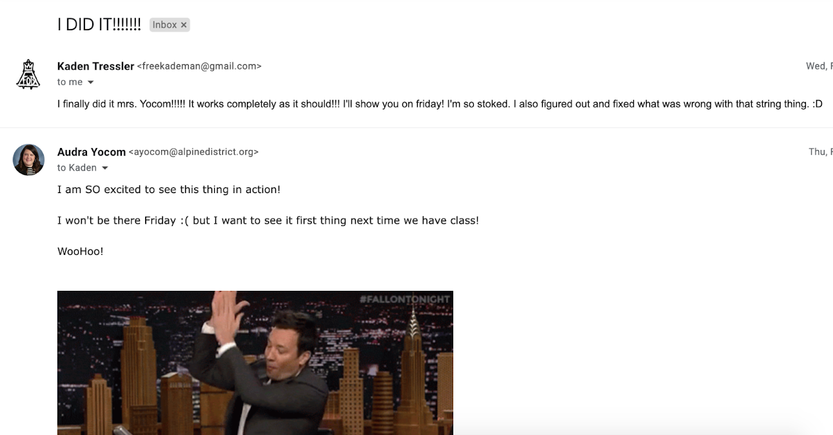
Why esports?
Notes:
Flash forward a few years, and I’m sitting at parent teacher conferences one night, I see this email come through from one of my programming students.
He was the type of student who had really wanted to know how programming worked, but he wouldn’t do the assignments I gave him - instead he worked on his own projects and this email was a celebration of a breakthrough he had just had. Honestly the BEST email I have ever received or ever will receive while sitting at parent teacher conference.
I’ll never forget the day, just two months later, when this student, who wasn’t on the school’s suicide watch list, died by suicide.

Slide 12
Why esports?
Notes:
Reading this email from my school, I was in shock.
While attending his memorial service, his mother told me that smash club was one of the places he actually felt connected to the school.
It was at this point in time when I realized how much this club was providing to students beyond gaming.

Slide 13
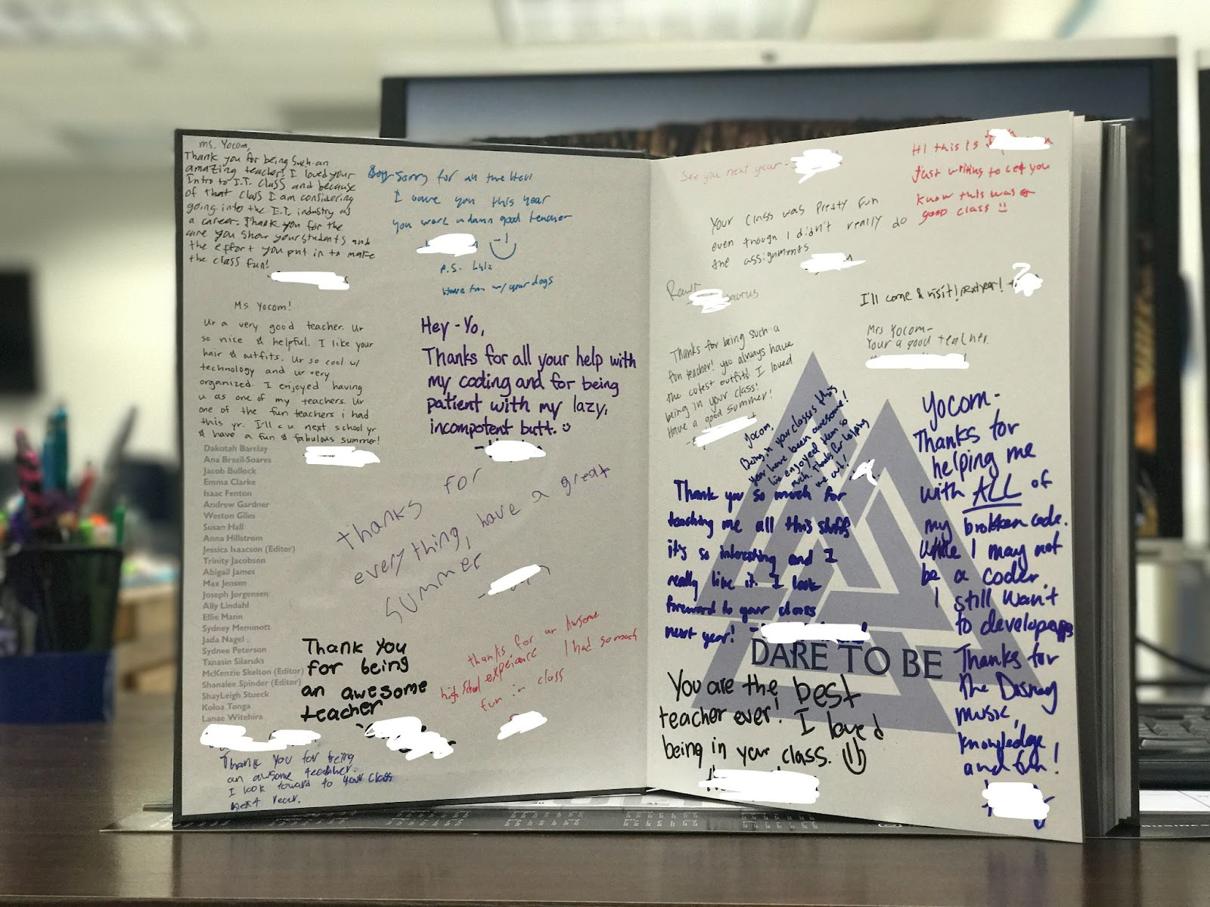
Notes:
For me, with everything I was going through and what I was watching my students go through, the social emotional wellness aspect of gaming was obvious. Students who otherwise wouldn’t have stepped foot into my classroom were now spending as much time as they possibly could in there. My classes were filling up as students got to know me and they were less afraid of the technical courses I was offering.

Slide 14
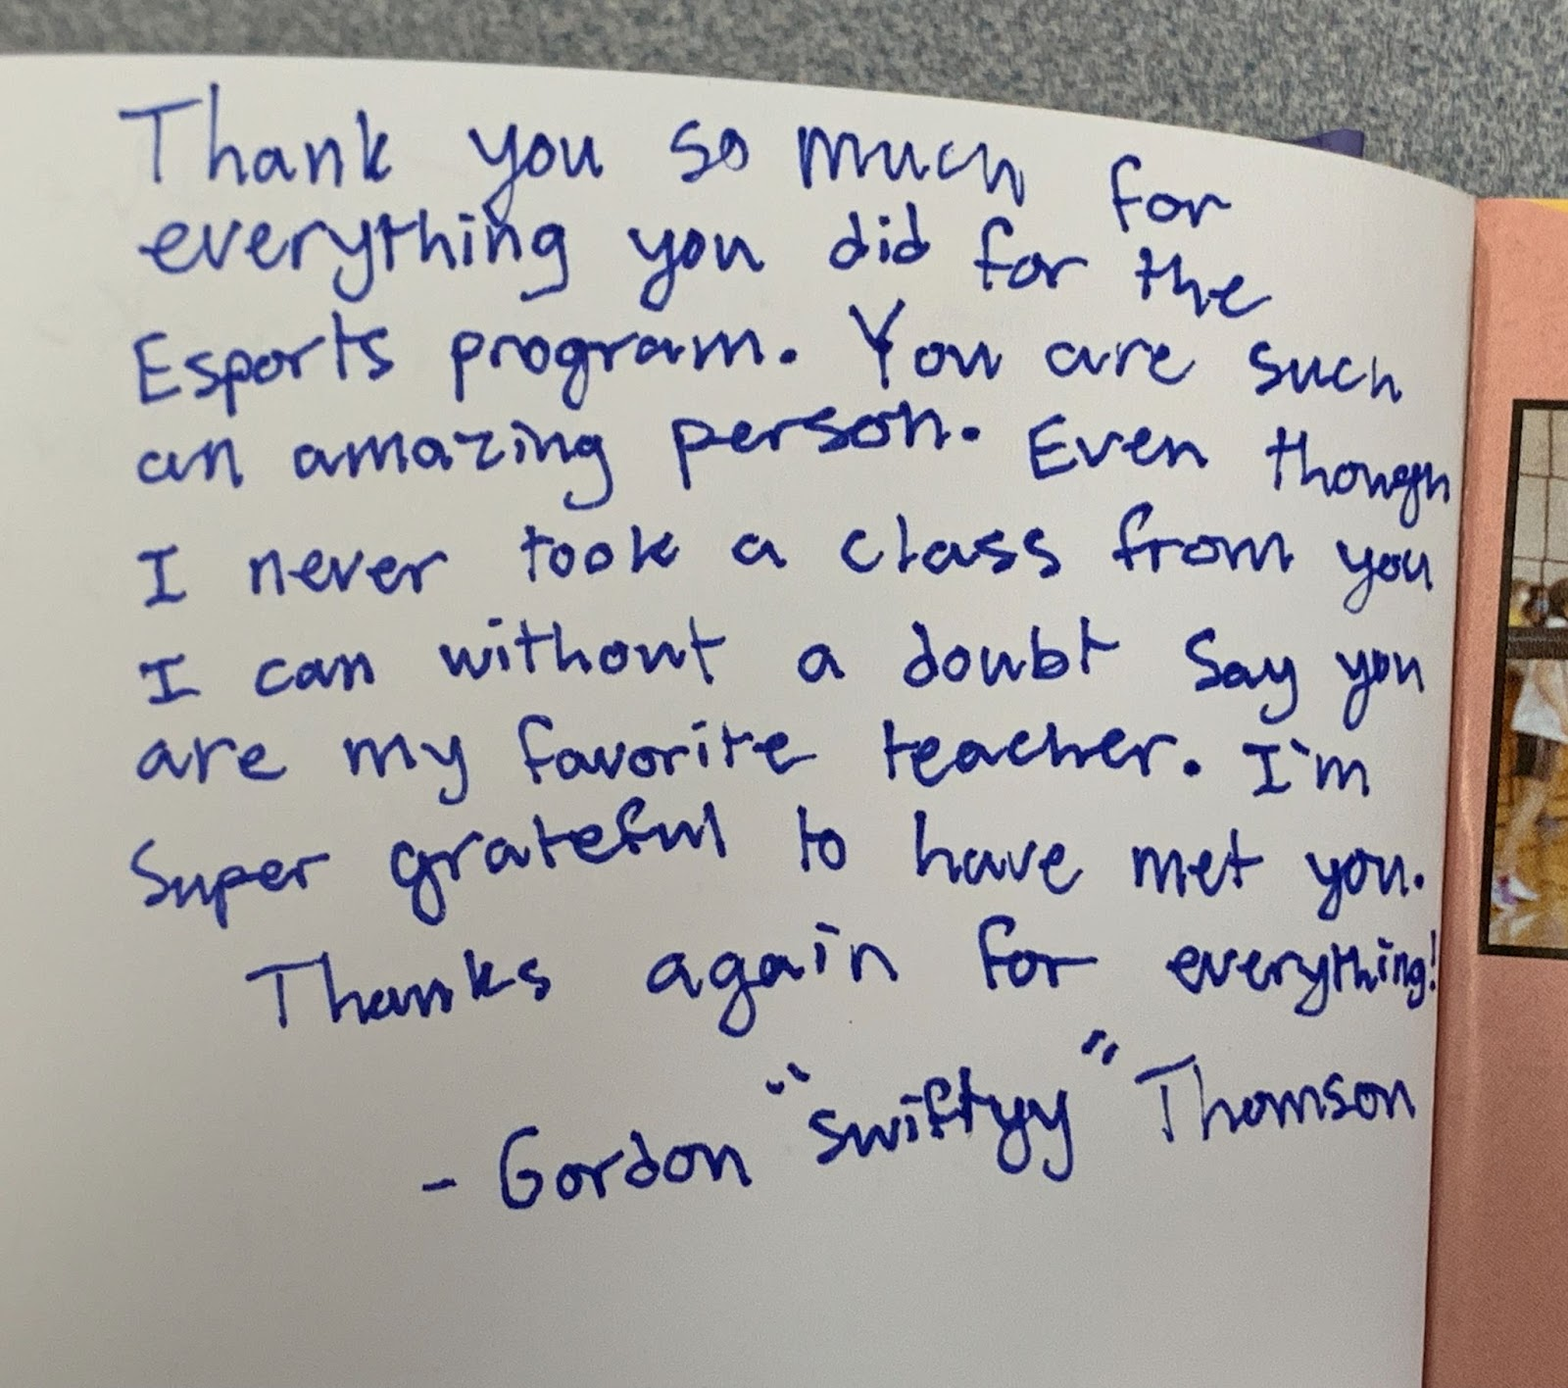
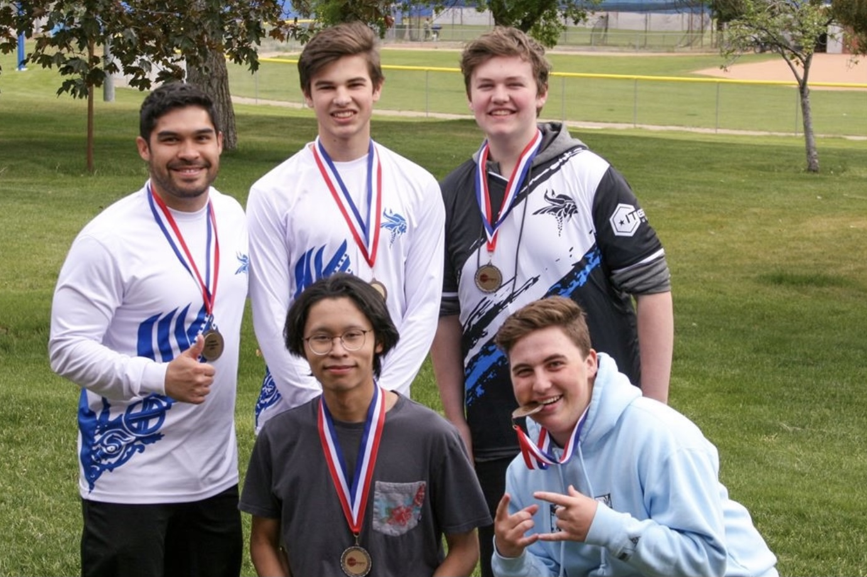
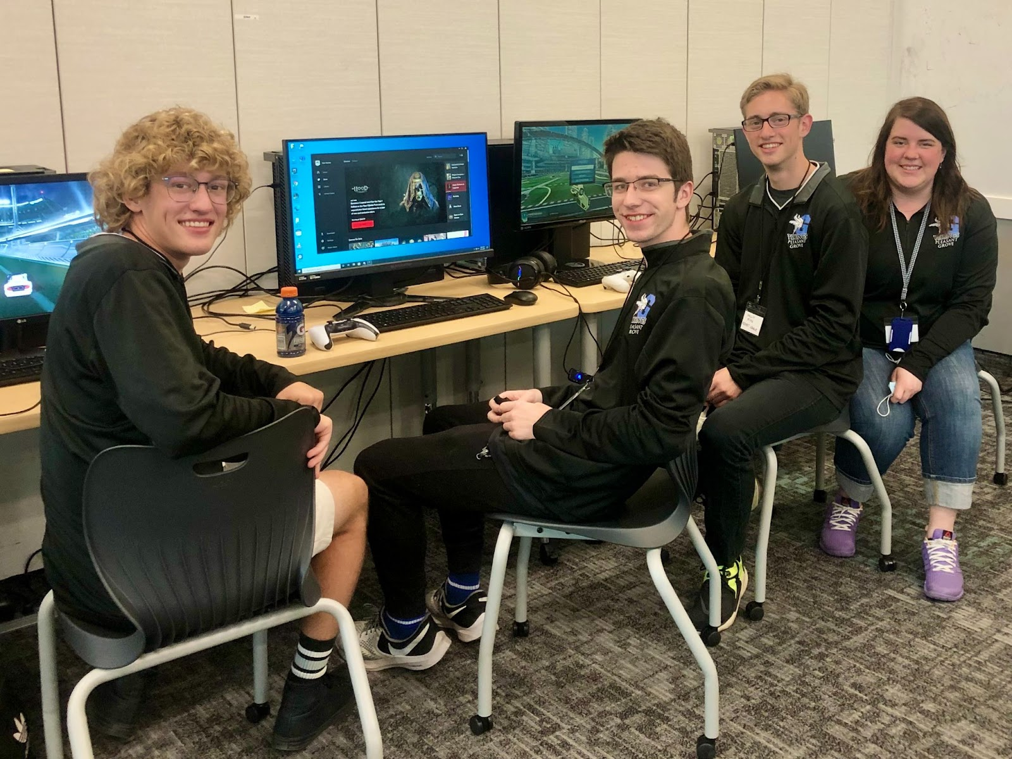
Notes:
I still consider myself a beginner when it comes to the actual gaming portion of what we are doing, the students have really stepped up to help me bring this to PGHS as a student-led club and last year we actually won the state competition for Rocket League and came in 3rd for League of Legends.
The Rocket League team went on to compete nationally and placed 23rd in the nation, securing $1300 in scholarship money. We have had students from Alpine school district earn scholarships in rocket league to USU Eastern and Ken Garff Esports has launched a partnership with the University of Utah’s Entertainment Arts and Engineering program to offer scholarships to students in our clubs.
Now I only had 1 of these rocket league players who hadn’t taken any of my classes from me. and this is what he wrote in my yearbook.
I can guarantee you if he wasn’t a senior, I would have had the opportunity to work with him in the classroom.
His counselor told me he wouldn’t have graduated without the motivation of esports to keep him coming to school.
A few months after graduation he came back and told me that this club helped him through his suicidal ideations while he was in high school.
For me, building those connections for students to each other and the school is my big “why”.
But bringing students into the technical classroom where they get immersed in the environment of technology education is huge.

Slide 15
How esports compliments CTE
Pathways, curriculum, existing resources

Slide 16
How esports compliments CTE
Notes:
While there is currently no official partnership with CTE, I strongly believe the career pathways esports promotes, strongly aligns to many of the career pathways highlighted by Career and Technical Education.
From personal experience with my own courses and students, the correlation is obvious. And as a computer science teacher, I already have a technical classroom where esports, and the activities that go with it like shoutcasting, align very well.

Slide 17
Notes:
https://www.varsityesportsfoundation.org/research

Slide 18
Notes:
https://www.varsityesportsfoundation.org/research

Slide 19
How esports compliments CTE
Notes:
Recognizing the obvious impact my gaming club was having on my enrollment numbers, I started researching esports and approached my CTE director, Michelle Price, about the potential of adding a more official program to our schools. She wisely directed me to the district psychologist to talk about student wellness and approached technology to see if this would be feasible.
We discussed how having a space at school where students were supervised and could interact with each other, bringing them out of their basements or bedrooms where they are often isolated when playing games, could be a major benefit.
A structured environment would also provide opportunities for students to exercise teamwork, leadership, and resilience. In terms of our district’s vision for learning, this tied in very well.

Slide 20
Creative ways to offer more pathways
Creative solutions to staffing shortages, smaller class sizes, and increasing collaboration
”Advanced IT”
“Advanced CS”

Slide 21
Creative ways to offer more pathways
Similar to distance ed courses, but more interactive
Special focus on industry involvement, speakers, industry trips, and certifications
Alignment with concurrent enrollment and local university
“virtual” school to school

Slide 22
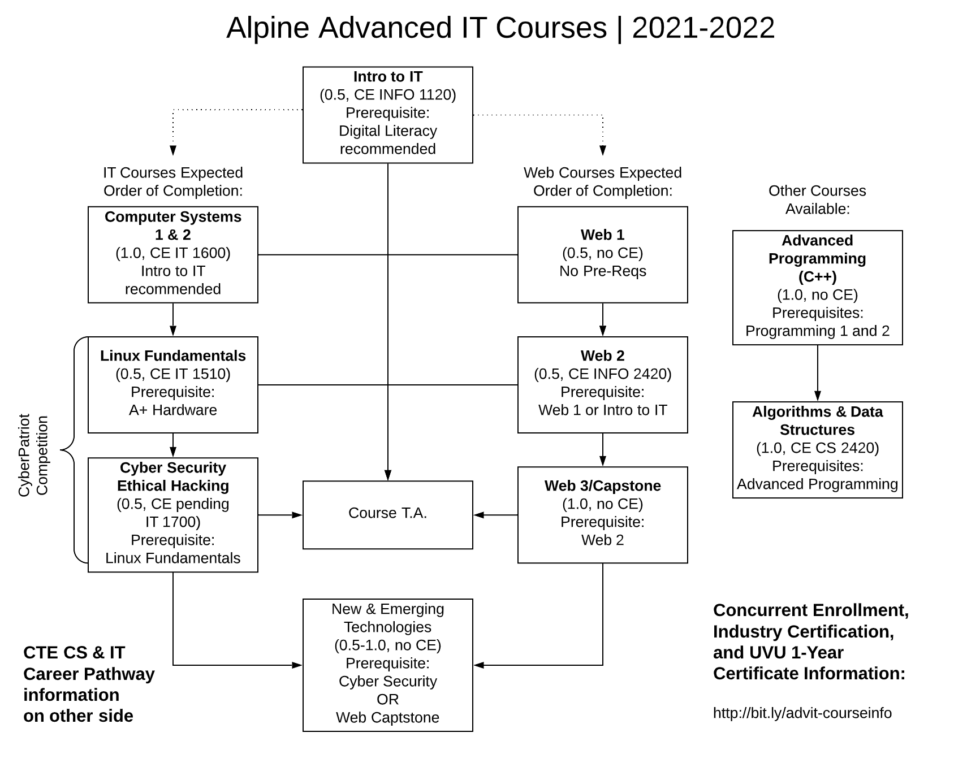
Creative ways to offer more pathways

Slide 23
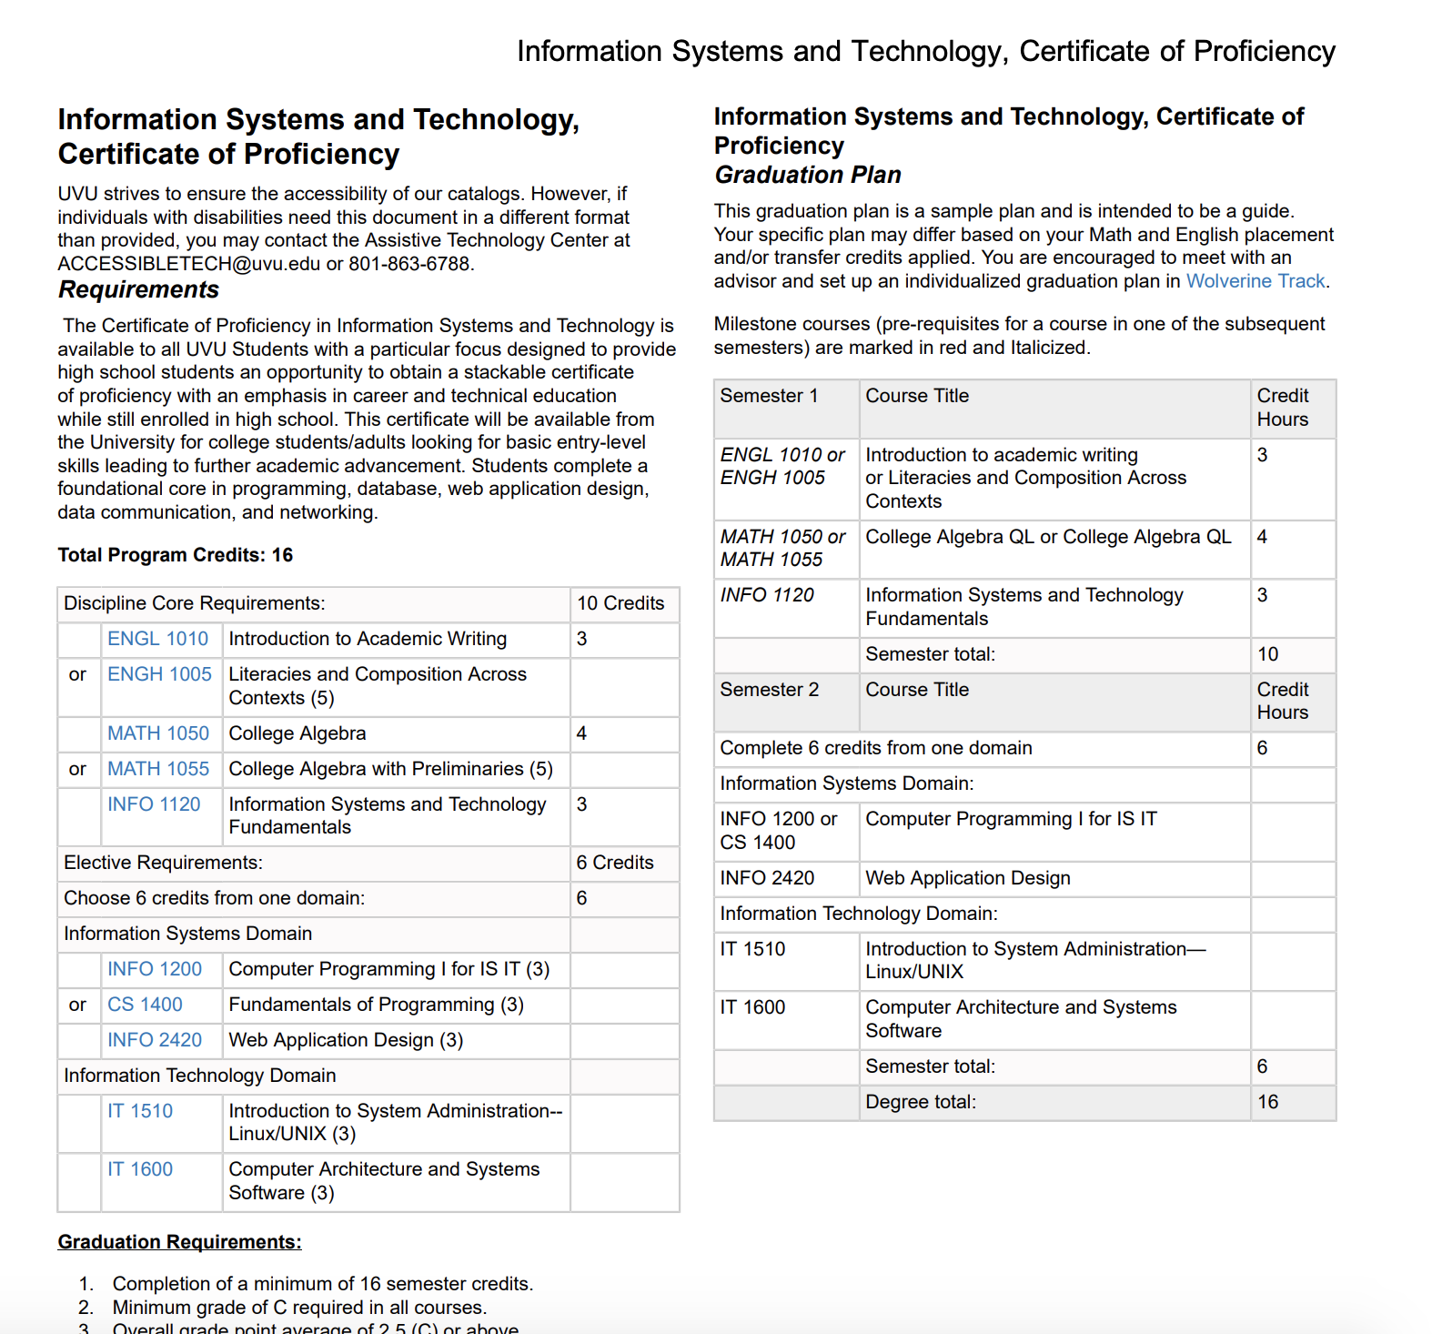
How esports compliments CTE

Slide 24
How esports compliments CTE

Slide 25
How esports compliments CTE

Slide 26
How esports compliments CTE

Slide 27
How esports compliments CTE
Cybersecurity
TestOut Courses
CyberPatriot
https://www.uscyberpatriot.org/
National Cyber League
https://nationalcyberleague.org/
CTFs
Pico CTF
https://picoctf.org/
Angstrom CTF
https://angstromctf.com/
Over the Wire Wargames
https://overthewire.org/wargames/
Make your own!

Slide 28
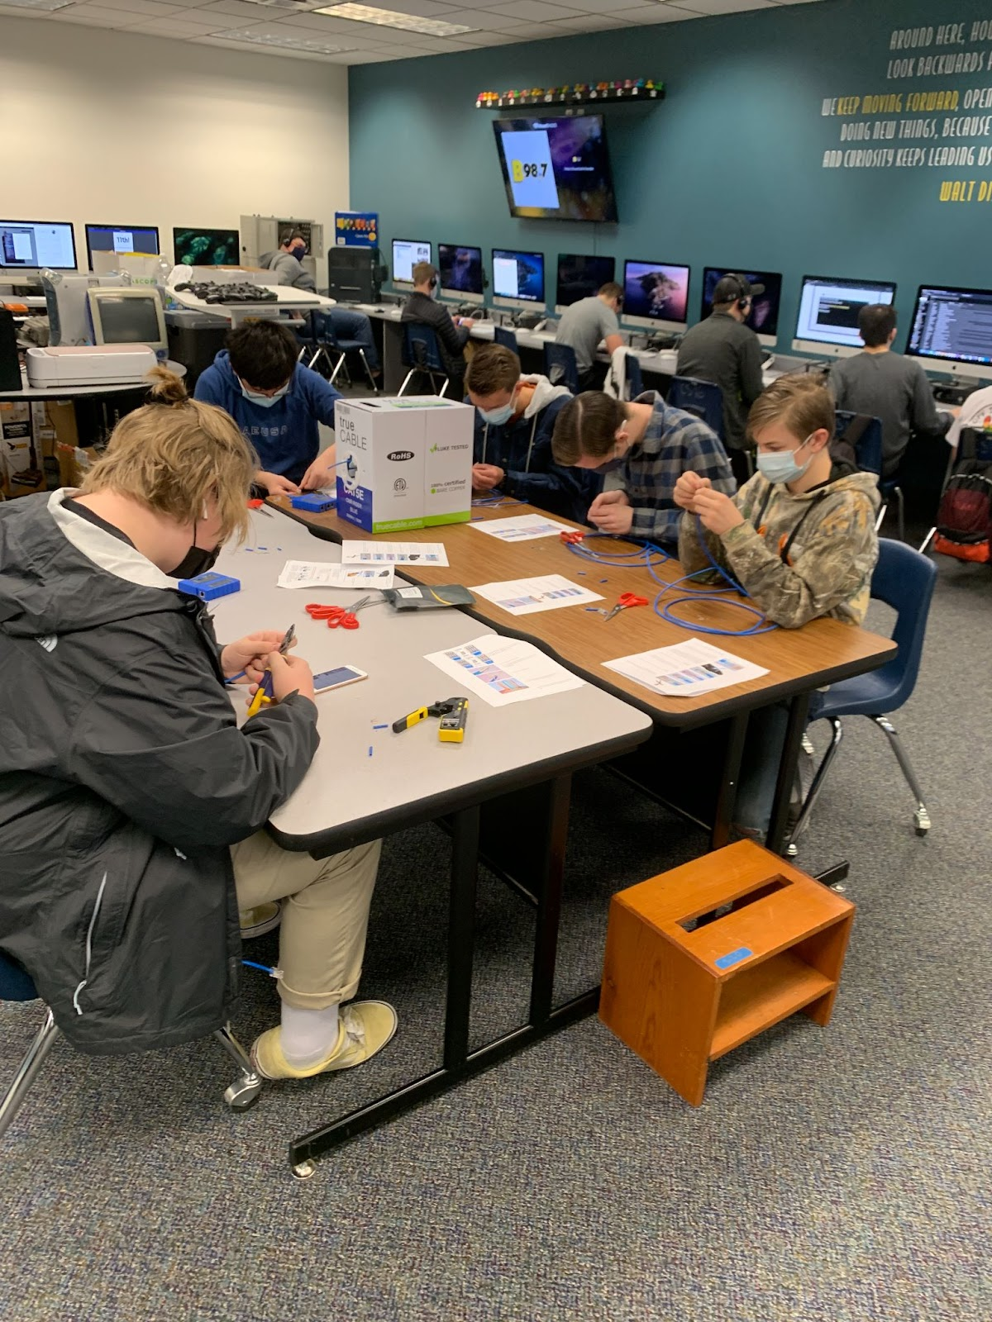
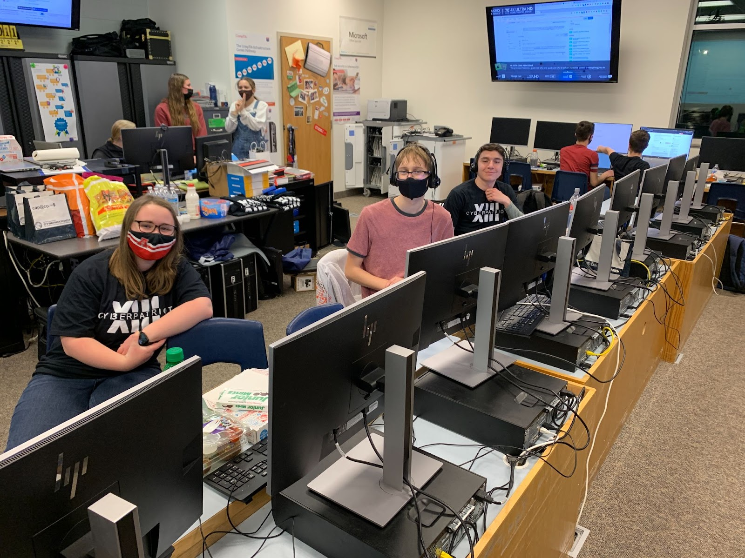
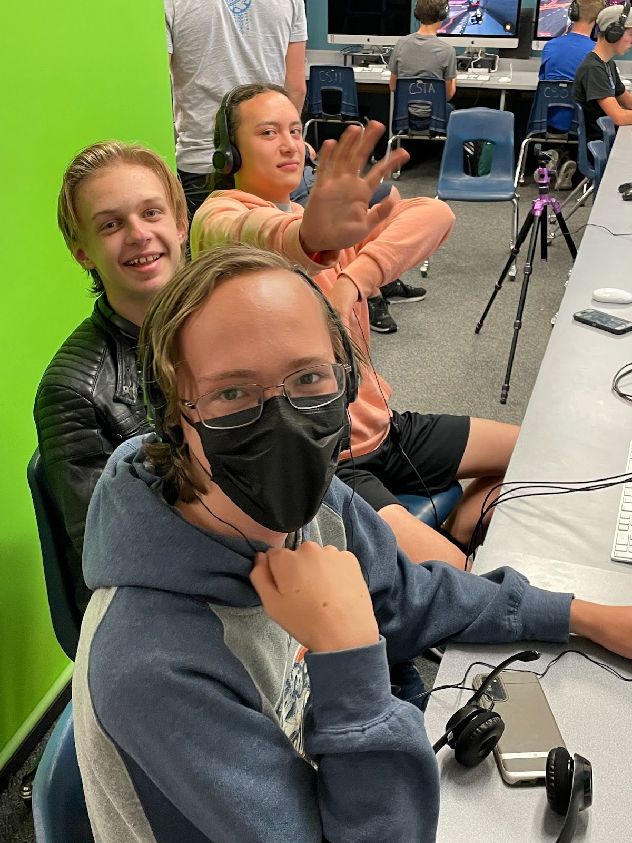
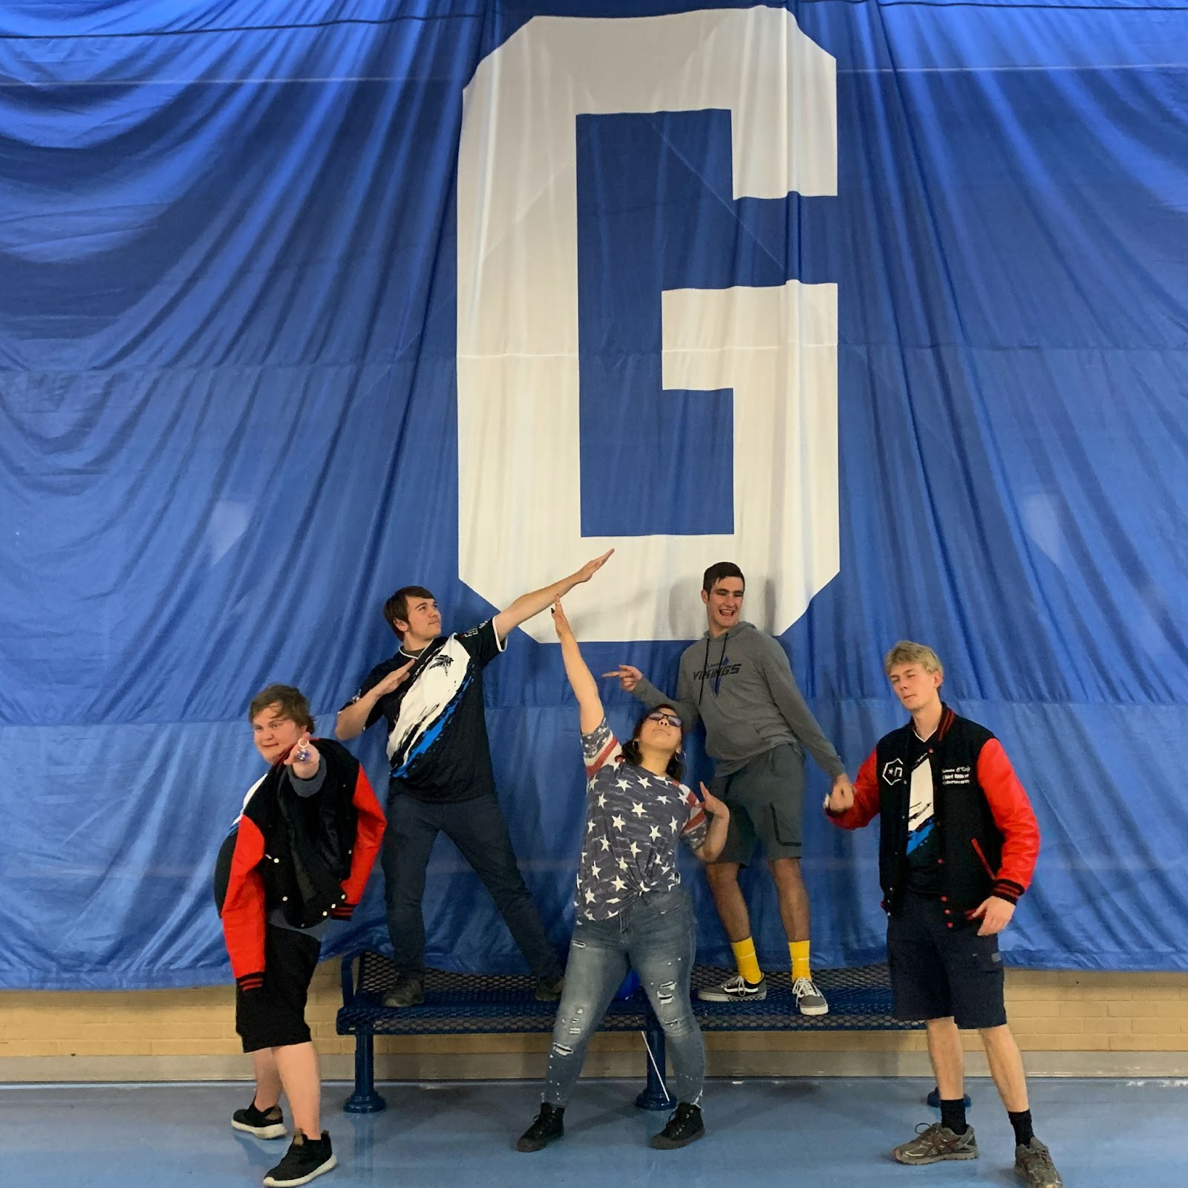
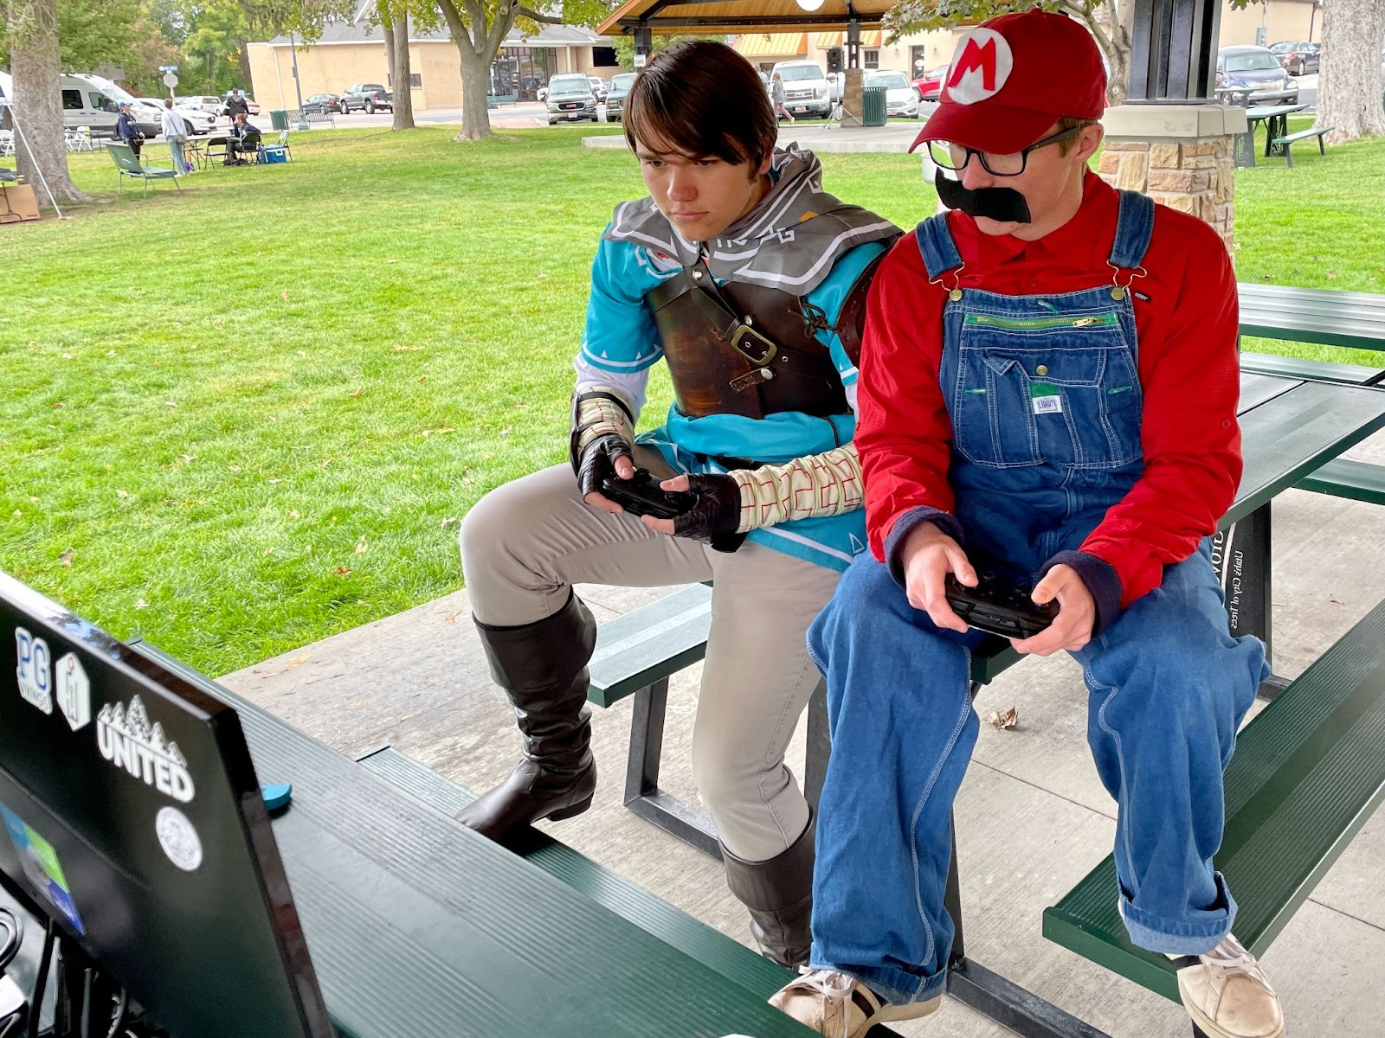
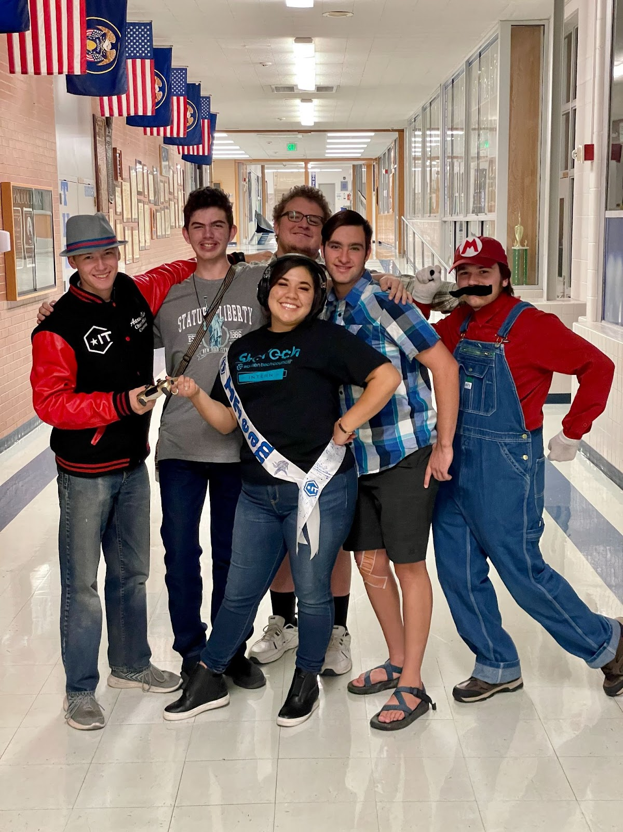

Slide 29
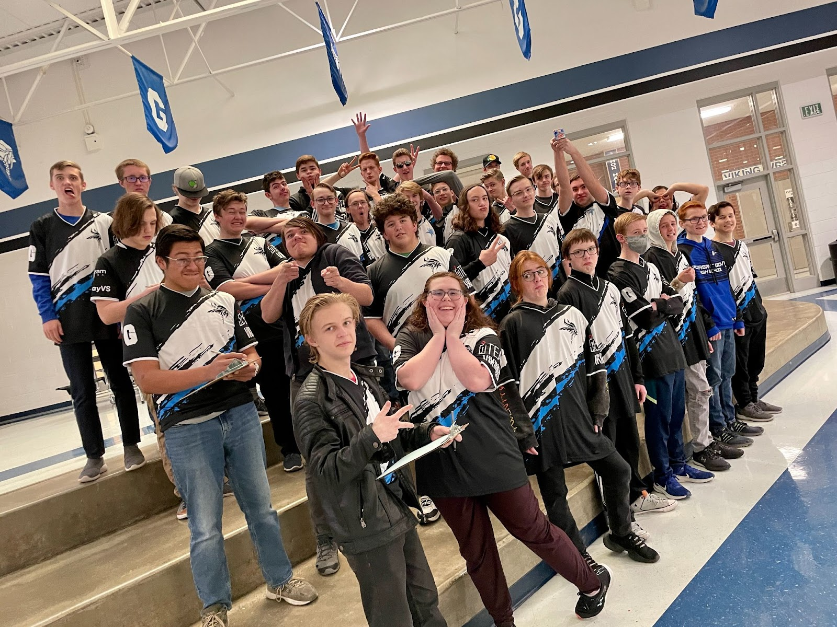

Slide 30
Additional Resources
One the next slide I will share some great resources / websites / examples
I avoid recommending “pay to play” platforms as much as possible, but some groups also really love them. I’ve done both with my students.
You can have a gaming club AND an esports team if you want the more competitive “sport” aspects without losing the inclusive community and scholastic tie-ins of the club.

Slide 31
Additional Resources
https://www.instagram.com/cyber.vikings
https://kengarffesports.org
http://instagram.com/kengarffesports
https://www.nasef.org
https://gsesports.org
Ken Garff Esports Youtube

Slide 32
Thank you!
Please feel free to reach out if you would like to talk about anything in more detail
audray@sieutah.org
ayocom@alpinedistrict.org
https://www.linkedin.com/in/ayocom/
https://twitter.com/audieannie
audieannie#1753

