Slide 2
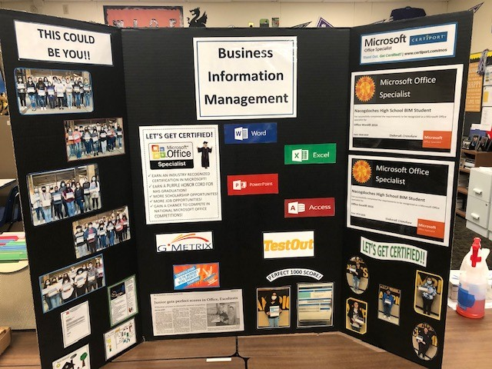
Preparing College and Career Ready Students for Success
“Nacogdoches High School CTE Recruitment Days For Middle School Students”

Slide 3
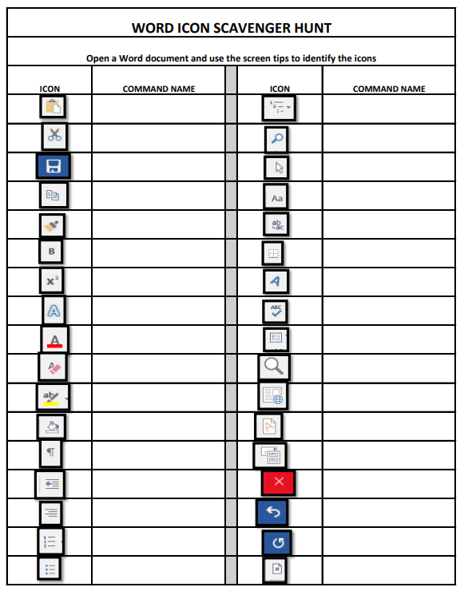
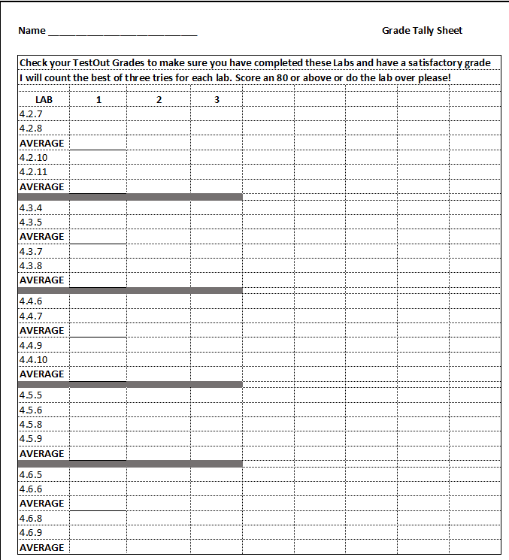
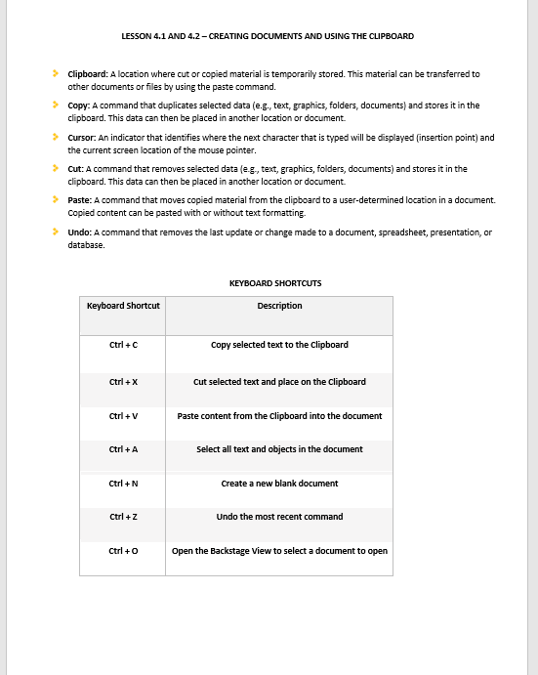
Reinforce Learning the TestOut Curriculum

Slide 4
Reminders and Study Guide Samples
CLICK TO DEMO

Slide 5
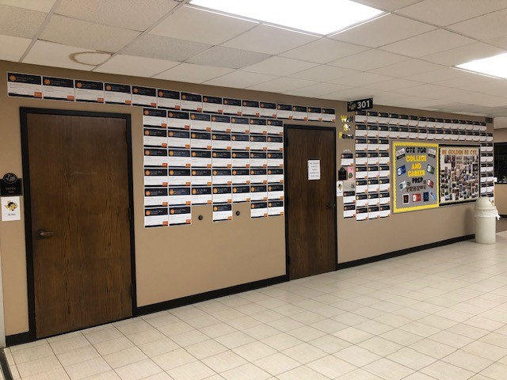
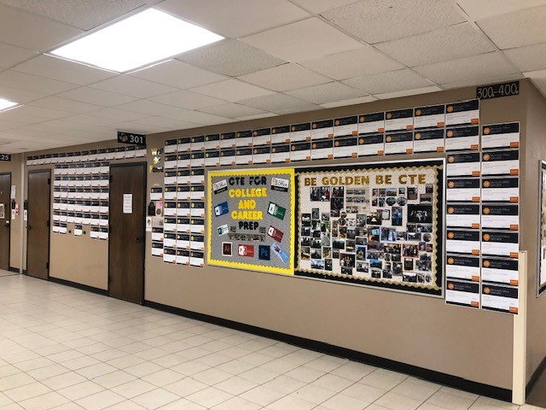
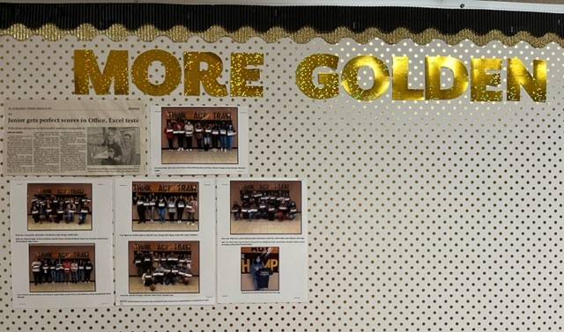
Celebrating Student Success!
Certificates are posted on my “Wall of Honor” and on my “Be Golden Be CTE” board

Slide 6
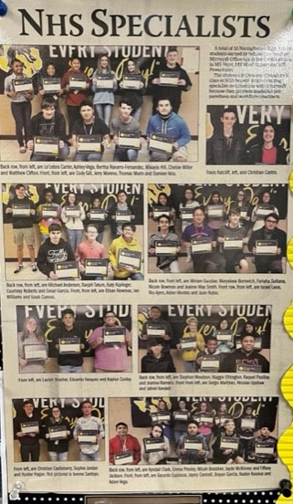
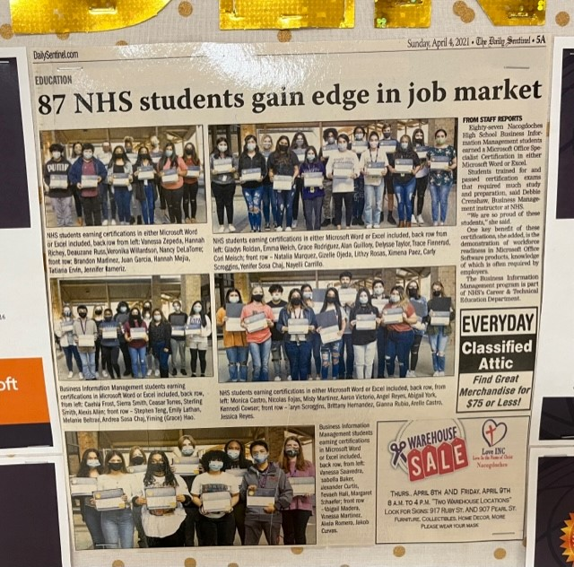
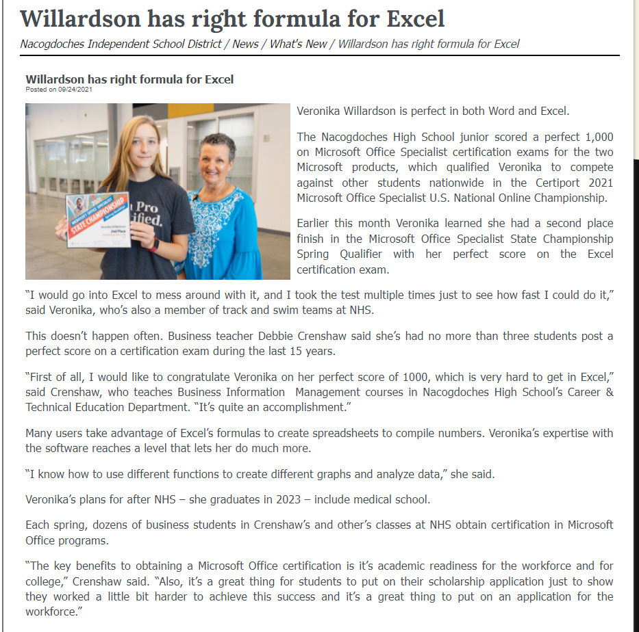
Celebrating Student Success!

Slide 7
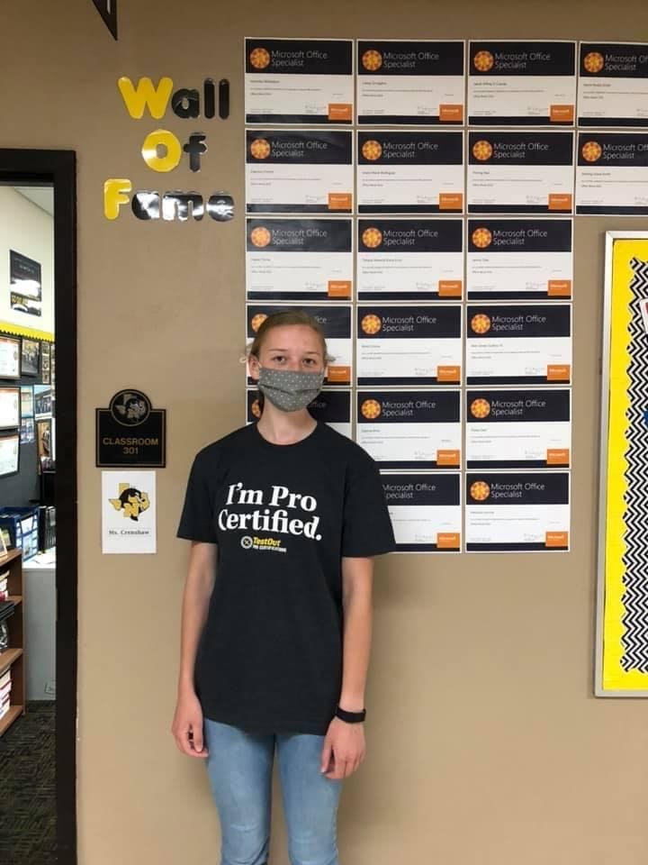
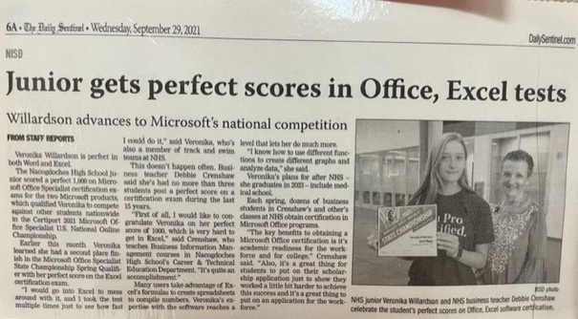
Celebrating Student’s Perfect Scores and 2nd in State in Excel!

Slide 8
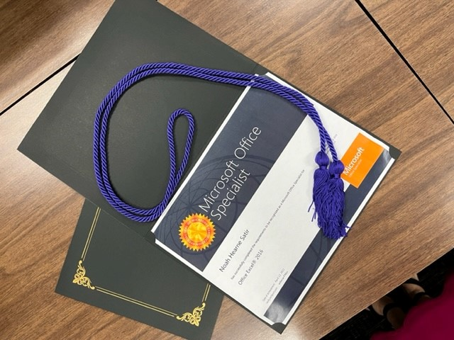
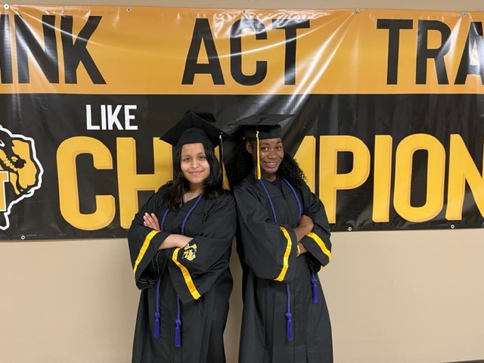
Honor Cords for Graduation!
For All Students Who Earn an Industry Based Certification

