Slide 1
NSITE High School
Certification Program

Slide 2
Certifications Taken & Passed

Slide 3
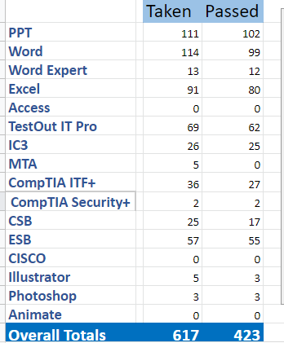
Certifications Taken & Passed

Slide 4
Students Need Variety…
During the Hardware portion this year, we took old desktop computers apart to identify most of the important portions and then I aske the students to put them back together
Mixing it up is important, and students will appreciate you trying to keep things lively, fun.
Quizlets, Kahoots, Quizzes to learn vocabulary
In-house competitions between classes
Charting progress, reviewing once a week

