Slide 1
Corrections Officer to Classroom Teacher
By: Kelly O’Dell

Slide 2
About Me:
First college graduate from my family on each side
I majored in Law Enforcement/Criminology
I never ran more than 1 mile until I was 30
I now run races that are 100 miles and longer
I didn’t become a teacher until I was 38 years old
I coach cross country and will lead an outdoor adventure club this coming school year

Slide 3
Goal Setting and Measuring
Take out a piece of paper
Draw a line down the middle so you have two columns
Think of a goal that you set in the past and accomplished it
Write it on the left side of the paper
What actions did you take to get to that goal? Try to produce at least 3 actionable steps you took and write them down.

Slide 4
Community and Support
Ultrarunner Community vs Educational Community
Diverse and eclectic
500 friends
Learn so much from others
Opportunities for travel
So many ways to give back
Side by side with professionals and newbies
Super important to have a support team
Notes:
The ultrarunning community is a good mix of people from different backgrounds. We also all have different goals. Some of us are there to win, some of us have found a community we feel that we belong too, ultrarunner also seems to be positive and uplifting environment. The same goes for teaching, some of us come from families where everyone is a teacher or works in education while others like myself comes from a family where I am the first college graduate. Never assume a coworker background, history or agenda because we all come from different places and opinions, but this is what helps form a diverse system. A system where we can learn and lead others. The student side of the education system is one thing but the education system and all the moving bodies in it, is another side that we must not ignore.

Slide 5
New Goal
Think of a new goal you would like to set. It can be a personal goal, professional goal, spiritual goal, etc.
Write your new goal on the right side
On the left side where your previous goal is written, I want you to write the people and support you received.
Maybe it was a spouse, a partner, a co-worker, etc.
Who can help you with your new goal?

Slide 6
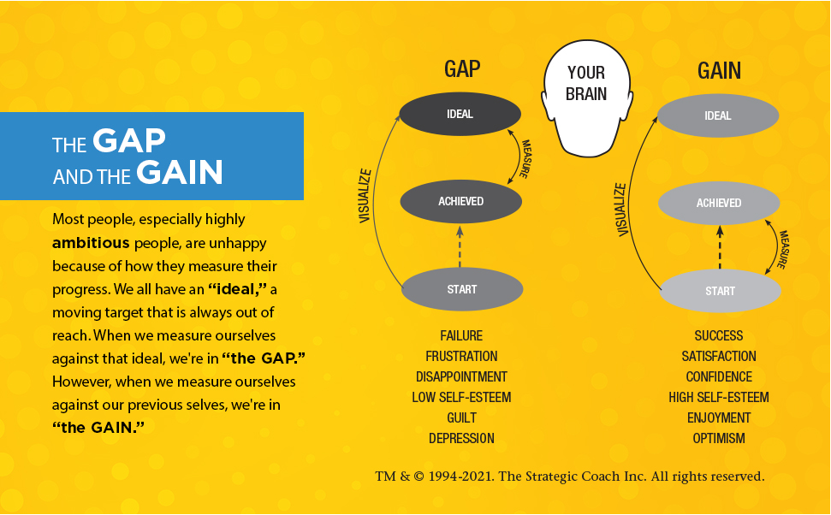
Mental Outlook and Measuring Success
Notes:
Understanding how you measure your goal is an important step to success. Most people assume that they “are successful once they hit their goal” but that means during the time that they are working towards that goal they are still “unsuccessful” because they haven’t hit their goal yet. Learning how to measure your goal from the bottom up and celebrate small victories along they way to your goal will help shape a more positive outlook mentally. Neuroplasticity is the “rewiring” of our brain. This is a common phenomena that happens when individuals have near death experiences, cancer survivors, etc. We don’t have to have a catastrophic event take place in our life to take advantage of neuroplasticity. Learning to “rewire” our progress can help with our overall mental health and success.

Slide 7
The Long Haul for Runners and Students
The finish can feel so very far away. How do we chunk things down into manageable pieces?
It’s all fun in the beginning until it’s not.
Having solid “seen” benchmarks helps us always know “where we’re at”
How do we measure our “gain”, how do we help our students measure their “gain”?
What happens mentally when we don’t measure our “gain”?
What happens when we/students don’t have any “gain”?
Notes:
When running long distance, I sometimes “play games” in my mind and reward myself with small treats. For example, “when I get to that tree up there, I’m going to stop and stretch”, “when I hit mile 60, I’m going to get my ipod so I can listen to some music”, “when I get to mile 70, I’m going to have my daughter run 5 miles with me”. There is nothing wrong with rewarding yourself for what you are doing. I do this in the education arena too. If we’re in a tough chapter and it’s dragging on, I’ll tell myself (and my students), when we finish this chapter we will do a fun project. Doing a project allows me time to relax in the classroom and interact more with my students on a one to one basis. I almost ALWAYS try to create a project where they can use a personal interest. Example: In IT Essentials Chapter 9, In section 9.3 we’re discussing and learning how to do data collection, input it into an excel file and create a chart or graph from the data. All my students are collecting data (of their choice), they love it. They are collecting data on shoes, animals, art, music, holidays, etc. They are 100% into this project and I get to listen and interact with them about their data collection and interest.

Slide 8
What were your “gains” in your goal?
Look back on the left side column – Write down 3 measurable steps that would have helped you measure if you were making gains?
Did you celebrate them when they happened? Is it easier to look back and say “oh wow, yeah those were milestones”
What small gains will you be sure to notice and celebrate with your new goal? Write down three of them.

Slide 9
Resources and Support
When running long distance, a lot of runners rely on a crew (their support team)
When teaching who do we use? Who is your support team?
I came in as a new IT teacher and into a new IT pathway at our school.
Even beginners can have success (remember, measure from the bottom up)
Look for resources, I inquired to junk mail when I found TestOut.
Notes:
I have a guy, who I am very fortunate to be friends with. He is one of my best friends. We met about 10 years ago during a 24 hour race. We haven’t ran a lot of races together but he loves to crew. A crew is the runners support team. Depending on the course, they may drive ahead every 2-3 miles to give the runner aid or they may only be able to see their runner every 10 miles. It’s always different depending on the course. Without my crew, it would be hard for me to finish races. I could finish, but it would be extremely challenging. Teaching is no different. We could make it through the day, the semester and the entire year on our own but it would be harder. Find your crew. Who at your school is your crew? Who are you a crew for? I found TestOut when I was looking for a crew and I got one. I actually applied to “junk mail”, a little postcard sitting in my mailbox at school. I was a new teacher and was looking for support.

Slide 10
Resources and Support
Look back at your goal you met, write down two resources or support persons that helped you
Look at your new goal
Who can help you support the work that needs to be accomplished to meet this goal?
What resources could you use to meet this goal?
Write two resources down
Write two people that could/would support you

Slide 11
You Don’t Know What You Don’t Try
Trial and error in long distance races is how we learn
We take notes
We try different things knowing they might not work
We practice different things on long runs (nutrition, clothes, gear, etc.)
We should also be willing to fail at things when teaching
We should be taking notes (what worked, what didn’t)
Practice things beforehand (online quizzes, games, videos, etc.)
Check out new resources and ask for a trial
Take the risk
Notes:
Trial and Error, we never know what we’re capable of until we try. This is something that I live by and try to teach my students as well. Note taking and journaling is key though, you have to be able to look back and say what worked and what did not. I’ve created countless projects and lessons that ended up not being repeated or had to have a major overall done to them. One mistake when I first started teaching is that I would “practice” a project or lesson on my 2nd period, fix any issues and then do the perfected version with my 8th period. This wasn’t fair to my 2nd period so the next year I started planning and practicing a little bit more prior to just pushing something out to my 2nd period class. There’s different ways to identify a section where a hands-on project can be implemented. Look at the content and ask yourself, “Can I make art out of this? Can I let students choose their own area of interest?” Examples of ways I have incorporated projects into my classroom is by using clay, pipe cleaners, poster board displays, videos, commercials, everything!” It’s also not necessary for students to be working on the same thing. Let them choose their topic as long as it aligns with your curriculum.

Slide 12
Something New We Can Do
Look at your new goal on the right side of your paper
You should have written down by now who can support you in your new goal and two resources you could use to help you reach your goal
Now, think about something new you can add into your action plan that you’ve never done before to reach a goal (new app for tracking, supplements, professional development, mentor, strength and conditioning, looking closer at nutrition, etc.)

Slide 13
Resources
Sullivan, D., & Hardy, B. (2021). The gap and the gain: The High Achievers Guide to Happiness, confidence, and success. Hay House, Inc.
https://progressbyintention.wordpress.com/

Slide 14
Contact Information
Email: kodell@tvsd.us
Instagram: kellyorocks

Slide 15
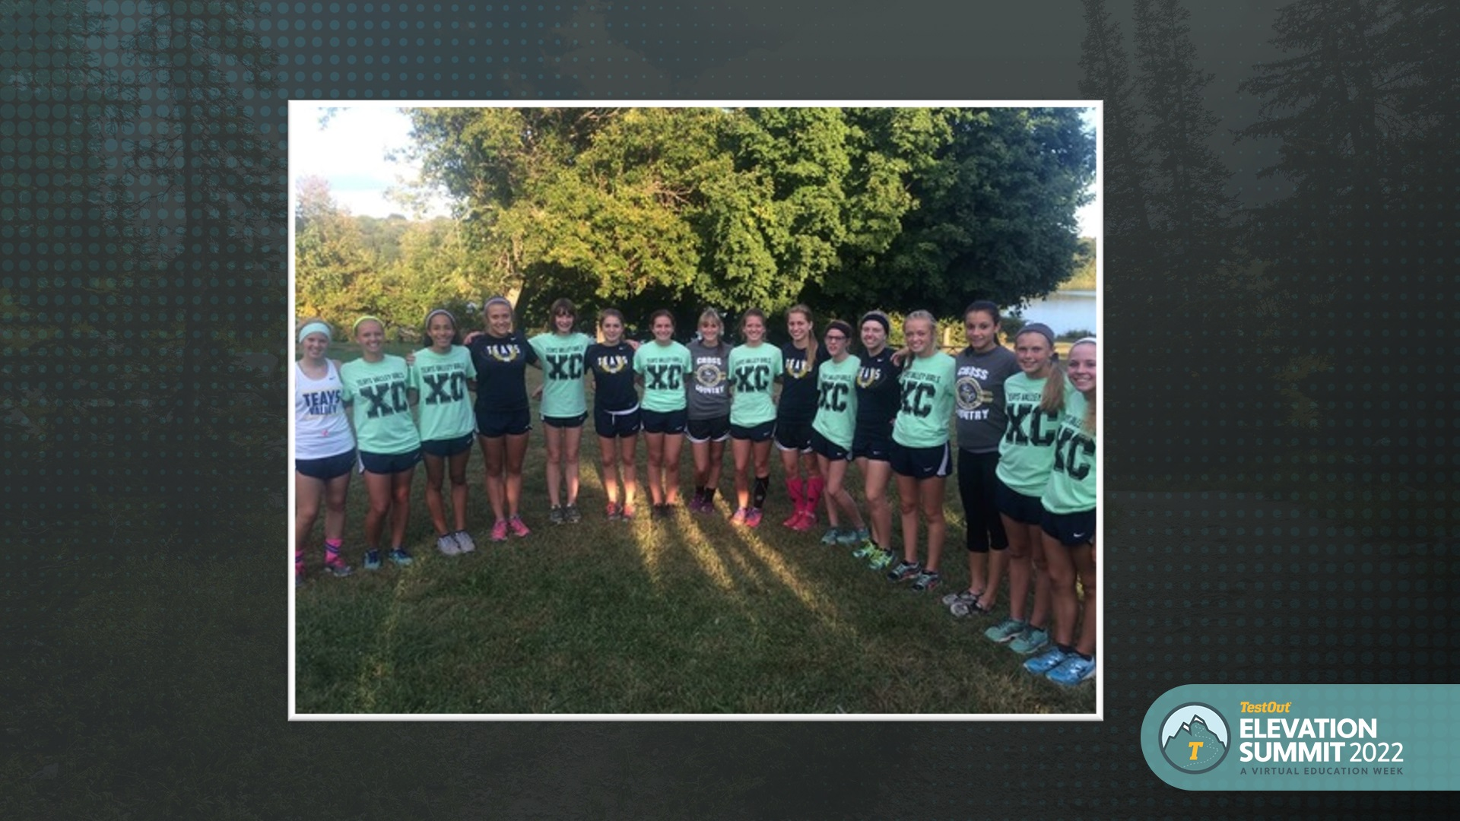
When You Can Smell The Finish
There comes a time in long distance running you start to “smell the finish”. That time comes differently for everyone. 10 miles left, 20 miles left and for some it’s only when there’s 2 miles left.
Never compare your finish with someone else’s
The end of the school year brings on exciting times for some and anxious and stressful times for others.
How do you support others when you’re getting close to the finish and they are as well?

Slide 16
When You Can Smell The Finish
There comes a time in long distance running you start to “smell the finish”. That time comes differently for everyone. 10 miles left, 20 miles left and for some it’s only when there’s 2 miles left.
Never compare your finish with someone else’s
The end of the school year brings on exciting times for some and anxious and stressful times for others.
How do you support others when you’re getting close to the finish and they are as well?

Slide 17
When You Can Smell The Finish
There comes a time in long distance running you start to “smell the finish”. That time comes differently for everyone. 10 miles left, 20 miles left and for some it’s only when there’s 2 miles left.
Never compare your finish with someone else’s
The end of the school year brings on exciting times for some and anxious and stressful times for others.
How do you support others when you’re getting close to the finish and they are as well?

Slide 18
Supporting You, Helps Me
How can supporting someone else keep you on track to meet your own goal?
Where can I apply this?
Is an accountability partner the same as my support?
Think of a situation that you can engage in during your journey towards your goal that you can support someone else.
Write down a couple ideas under your “new goal” column

Slide 19
Supporting You, Helps Me
How can supporting someone else keep you on track to meet your own goal?
Where can I apply this?
Is an accountability partner the same as my support?
Think of a situation that you can engage in during your journey towards your goal that you can support someone else.
Write down a couple ideas under your “new goal” column

Slide 20
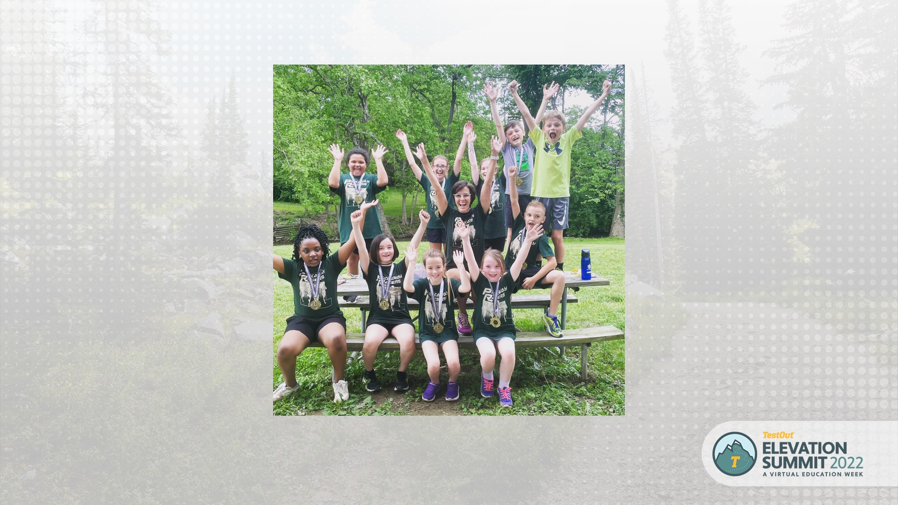
Supporting You, Helps Me
How can supporting someone else keep you on track to meet your own goal?
Where can I apply this?
Is an accountability partner the same as my support?
Think of a situation that you can engage in during your journey towards your goal that you can support someone else.
Write down a couple ideas under your “new goal” column

Slide 21
Supporting You, Helps Me
How can supporting someone else keep you on track to meet your own goal?
Where can I apply this?
Is an accountability partner the same as my support?
Think of a situation that you can engage in during your journey towards your goal that you can support someone else.
Write down a couple ideas under your “new goal” column

Slide 22
Supporting You, Helps Me
How can supporting someone else keep you on track to meet your own goal?
Where can I apply this?
Is an accountability partner the same as my support?
Think of a situation that you can engage in during your journey towards your goal that you can support someone else.
Write down a couple ideas under your “new goal” column

Slide 23
Supporting You, Helps Me
How can supporting someone else keep you on track to meet your own goal?
Where can I apply this?
Is an accountability partner the same as my support?
Think of a situation that you can engage in during your journey towards your goal that you can support someone else.
Write down a couple ideas under your “new goal” column

Slide 24
Supporting You, Helps Me
How can supporting someone else keep you on track to meet your own goal?
Where can I apply this?
Is an accountability partner the same as my support?
Think of a situation that you can engage in during your journey towards your goal that you can support someone else.
Write down a couple ideas under your “new goal” column

Slide 25
Supporting You, Helps Me
How can supporting someone else keep you on track to meet your own goal?
Where can I apply this?
Is an accountability partner the same as my support?
Think of a situation that you can engage in during your journey towards your goal that you can support someone else.
Write down a couple ideas under your “new goal” column

Slide 26
Supporting You, Helps Me
How can supporting someone else keep you on track to meet your own goal?
Where can I apply this?
Is an accountability partner the same as my support?
Think of a situation that you can engage in during your journey towards your goal that you can support someone else.
Write down a couple ideas under your “new goal” column

Slide 27
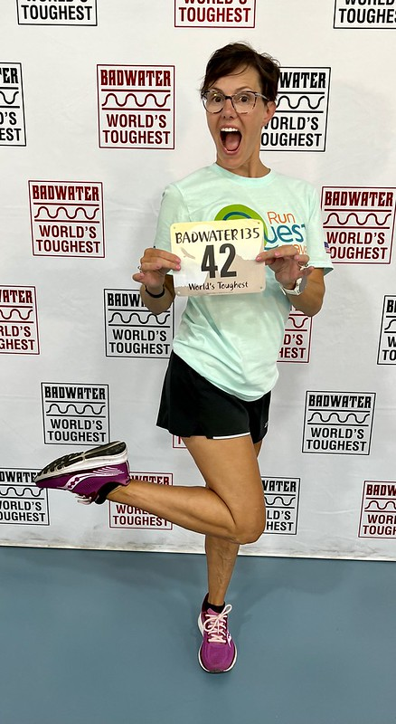

Slide 28
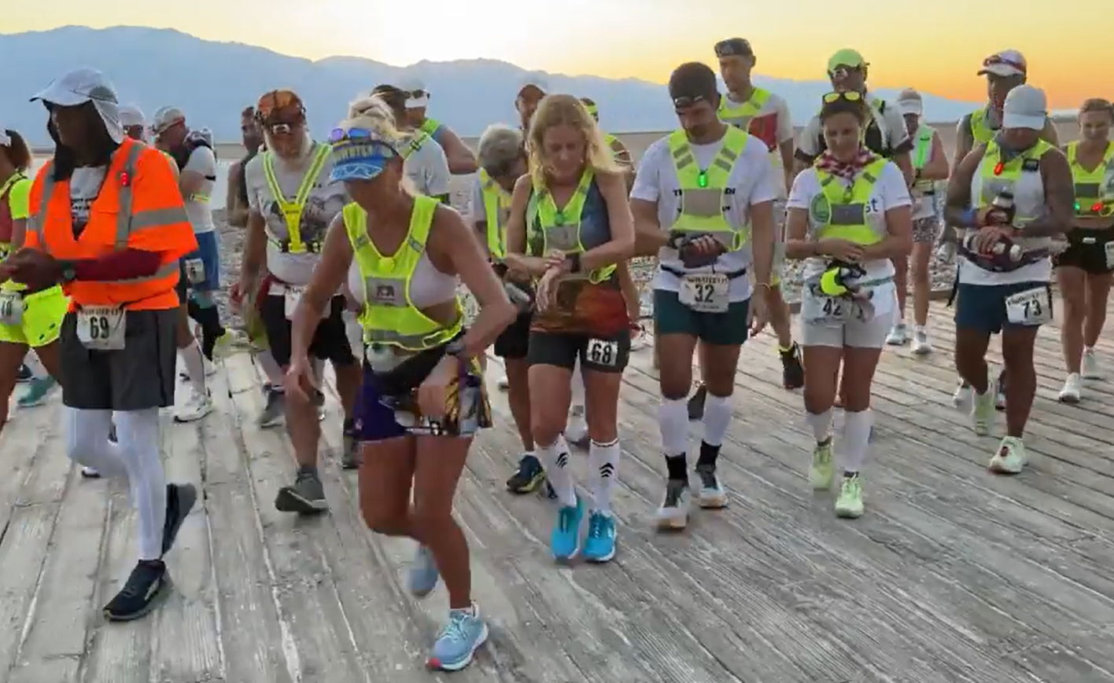
Badwater 135 2022
Kelly’s Start

Slide 29
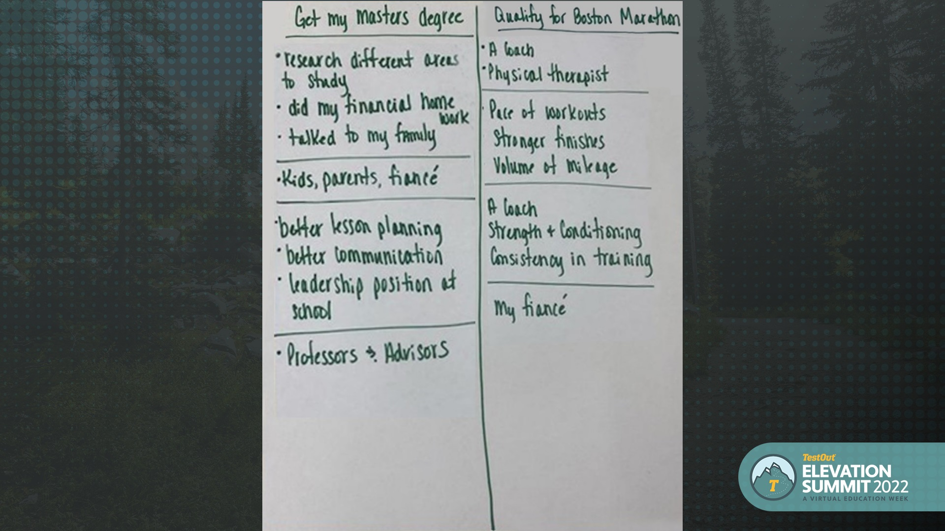
Badwater 135 2022
Kelly’s Start

Slide 30
Badwater 135 2022
Kelly’s Start

Slide 31
