Slide 2
Preparing Students for Certification
Meghan Burgin

Slide 3
Study Guides
Provide students with Study Guides for each exam
Word 2019 Associate
Excel 2019 Associate
PowerPoint 2019 Associate
Includes tasks from Objective Domains provided by Certiport
Students then record down how to do each task and use this to study and prep

Slide 4
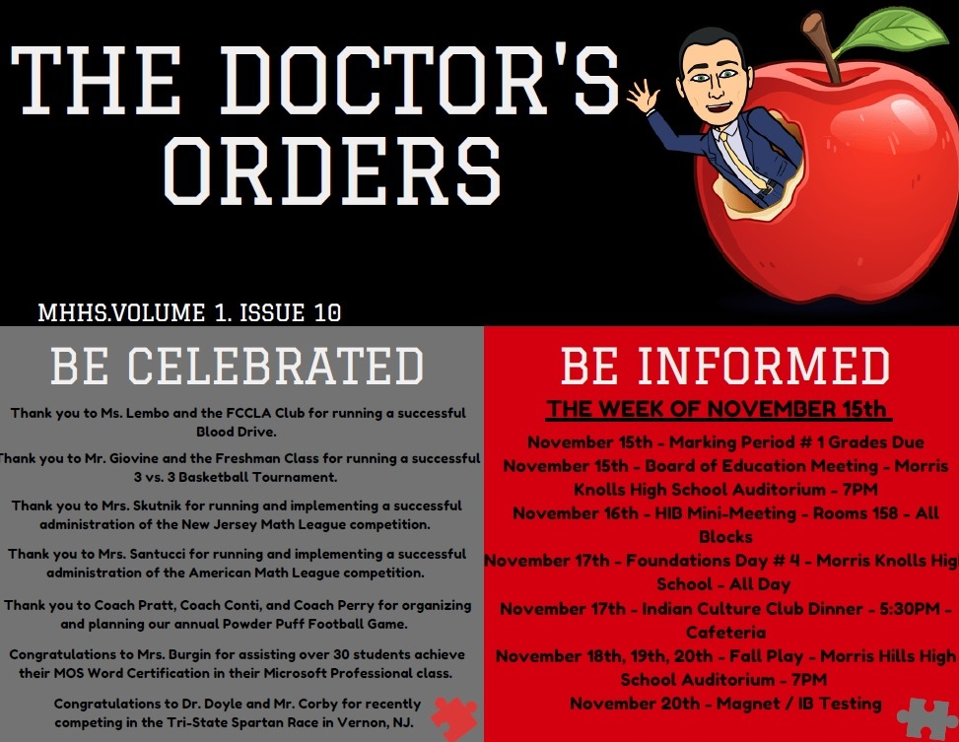

Slide 5
Celebrating Student Success
Send email to School Counselors, Principal, and ESL Teachers (if applicable)
Principal sends out congratulatory announcement via Staff Bulletin (pictured on next slide)
A certificate ceremony is held at the end of every marking period and students are given cupcakes in celebration!

Slide 6
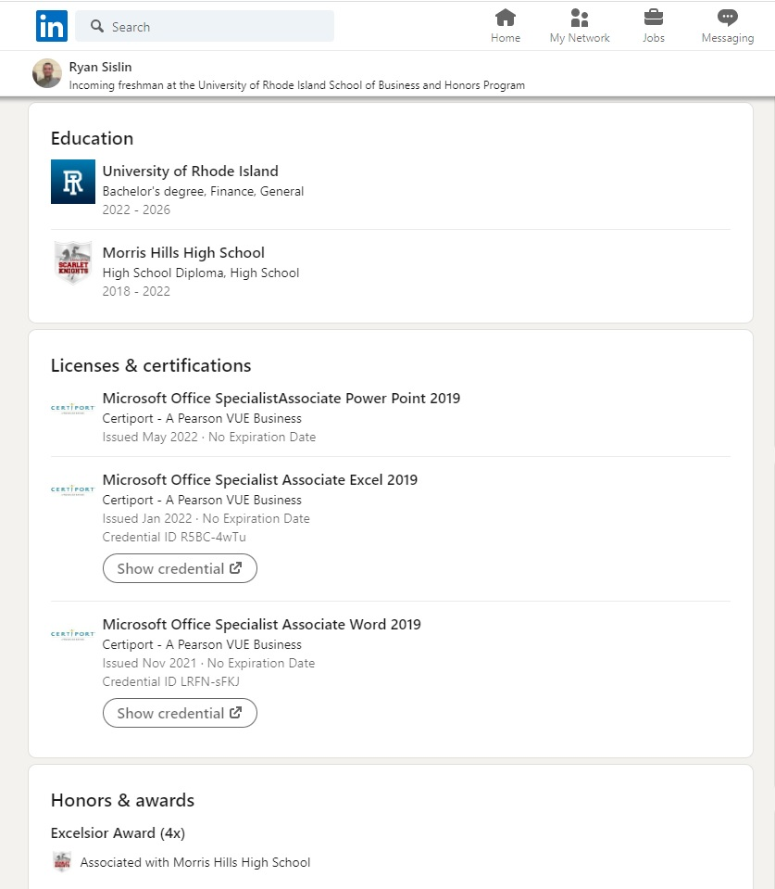

Slide 7
